Slide 1
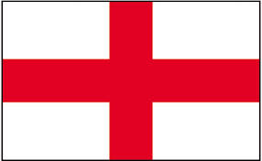
Education in England

Slide 2
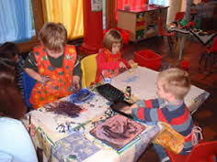
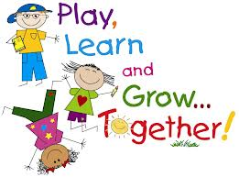
Nursery School or Pre-School
Children go to Nursery School from age around 6 months until they are 4 years old. Usually, parents have to pay.

Slide 3
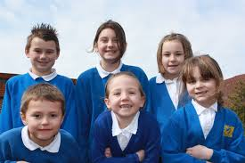
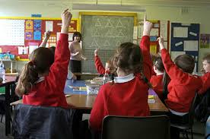
Primary School
Children go to Primary School from age 4 or 5 to age 11.
The first year of Primary School is called ‘Reception’, followed by years 1 to 6.
Children wear a uniform.

Slide 4
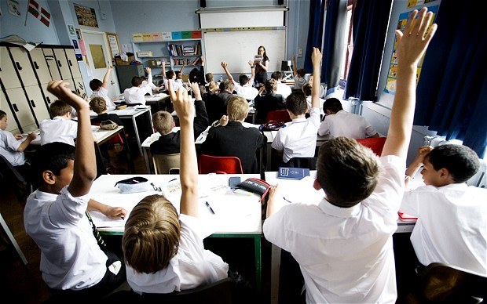
Secondary School
Children go to secondary school from age 11 to 16.
At age 16 the students take GCSE exams.
Some students stay until age 18 to take Advanced exams (A levels).
GCSE= General Certificate of Secondary Education.

Slide 5
GCSEs
Compulsory subjects at GCSE are English Literature, English Language, Maths, and Science.
Students then choose other subjects. They usually take between 9 and 12 subjects.
Exams happen in May or June of year 11, and results day is the middle of August.
GCSE= General Certificate of Secondary Education.

Slide 6
GCSE Grades
A*A B C D E F G U
Grades range from A*- G.
Grade C is a pass

Slide 7
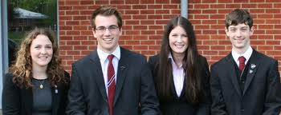
Sixth Form
Sixth Form is for students who get good grades at GCSE. They stay at school until age 18 to take their Advanced Level (A-Level) exams for university entrance.

Slide 8
A-level Grades
A*A B C E F U
Good grades are necessary to go to a good University.
Grade E is a pass at A-level, but good Universities want A* and A grades.

Slide 9
After School
Students with good A-level results can go to University.
Some students go straight into work or into apprenticeships after school.

Slide 10
There are different types of schools in England, but most schools are free to attend and open to anyone and everyone. These are called state schools. Maria Brigida is a state school.
Free Education

Slide 11
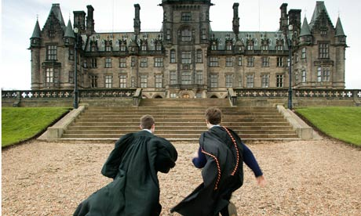
Some schools are private
Private or Independent Schools are able to select their students (usually with an exam) and charge fees. It usually costs between £10,000 and £15,000 per year.
Students have better facilities and better teachers.

Slide 12
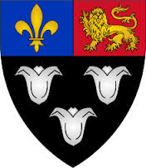
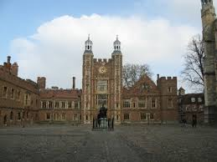
Public Schools
There are nine public schools in Britain
They are popular with the Royal Family and politicians.
The public schools are very expensive.

