Slide 1
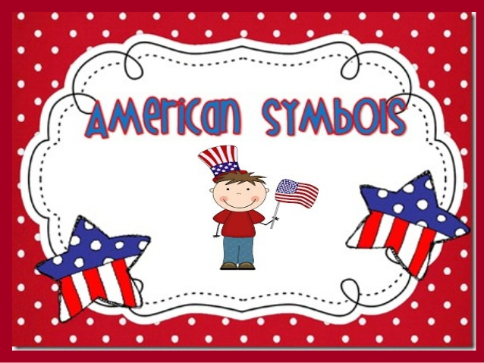

Slide 2
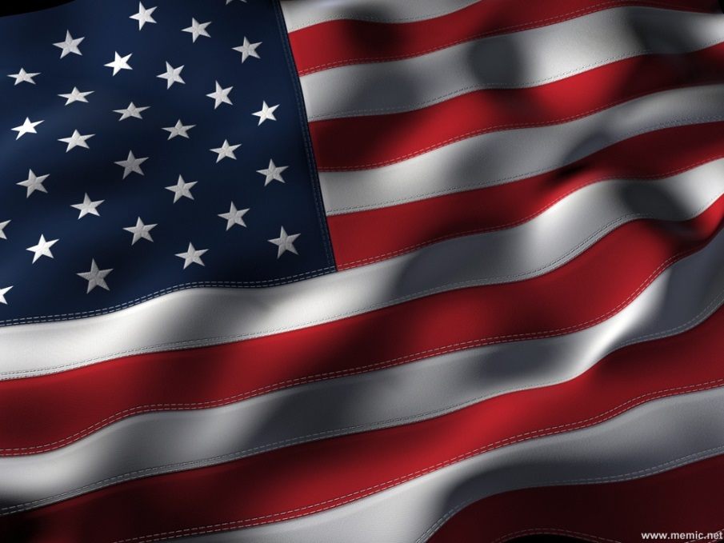
The U.S. flag
Also known as Old Glory or The Stars and Stripes is a strong symbol of American identity and national pride.
Stars are a symbol of the heavens; stripes are symbolic of rays of light from the sun.
Thirteen stripes represent the original thirteen colonies that declared independence from England; 50 stars symbolize the current 50 United States.
White signifies purity and innocence, red signifies valor and bravery; and blue signifies justice.

Slide 3
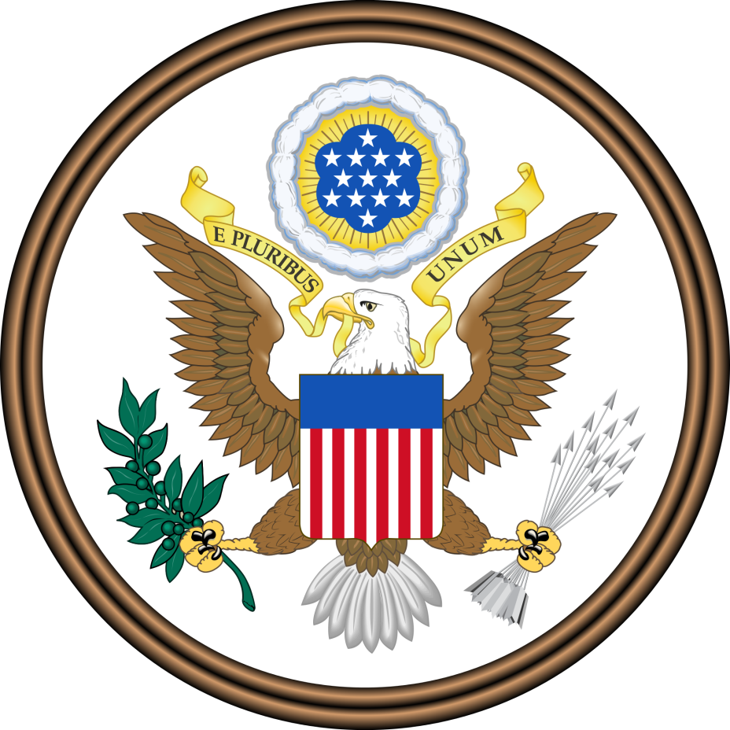
The SEAL
Eagle: In the center of the seal is a bald eagle (the national bird). The eagle holds a scroll in its beak inscribed with the original national motto: E pluribus Unum, which is Latin for one from many or one from many parts (one nation created from 13 colonies). The eagle grasps an olive branch and thirteen arrows in its left. They are symbols for the power of peace and war.
Shield: A shield with thirteen red and white stripes covers the eagle's breast. The shield is supported solely by the American eagle as a symbol that Americans rely on their own virtue.

Slide 4
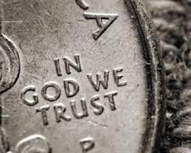
IN GOD WE TRUST is the national motto of the United States. The original motto of the United States was E Pluribus Unum (Latin for one from many or one from many part.

Slide 5
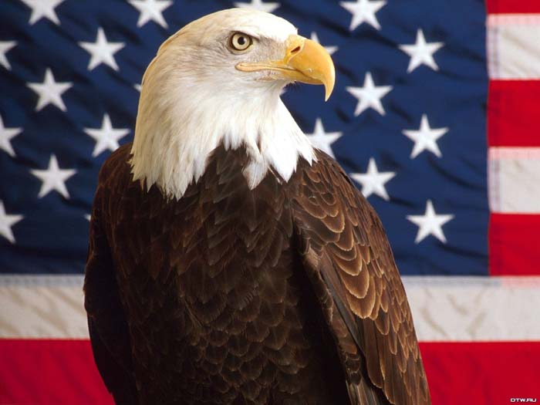
The American bald eagle was adopted as the national bird symbol of the United States of America in 1782.
The bald eagle was chosen for its majestic beauty, great strength, long life, and because it's native to North America.

