Slide 2
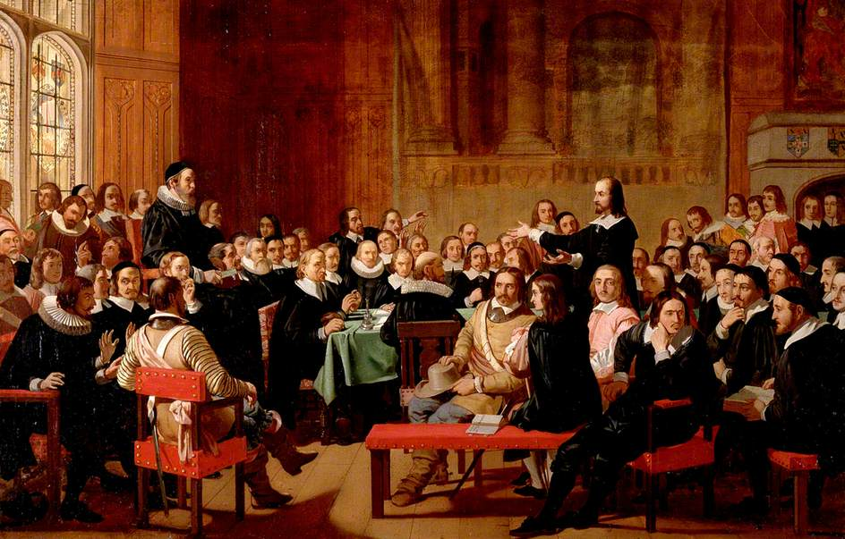
In the 17th century, groups of Europeans created the first colonies along the east coast of North America. The most famous of these settlers were the Pilgrim fathers. They were a group of Puritans who were looking for a place where they could live free from persecution.

Slide 3
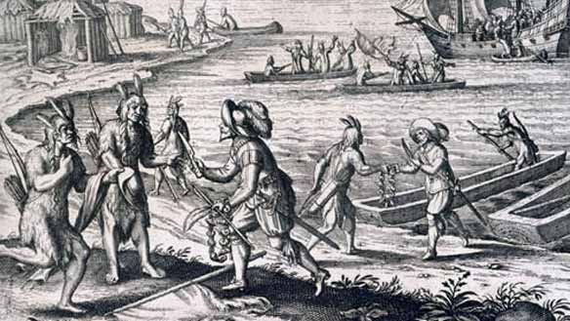
At the same time some English businessmen were looking for people to go to Virginia to work for them and they paid the Pilgrim Fathers to go to the New World.

Slide 4
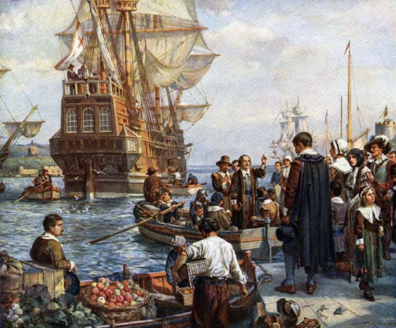
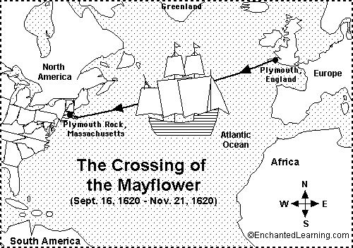
In September 1620, 102 people left Plymouth in England in a ship called The Mayflower. In December 1620, after a terrible journey in bad weather, they arrived in their new land.

Slide 5
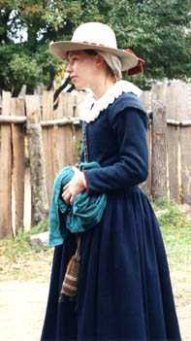
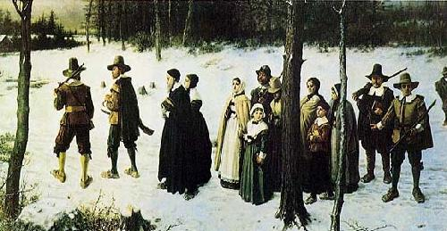
Puritans believed in a simple life of hard work, prayer, and no fun. This attitude helped them during the first difficult year in America.
When they arrived it was winter, life was difficult and half of them died.

Slide 6
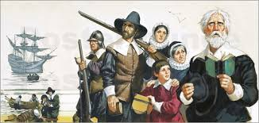
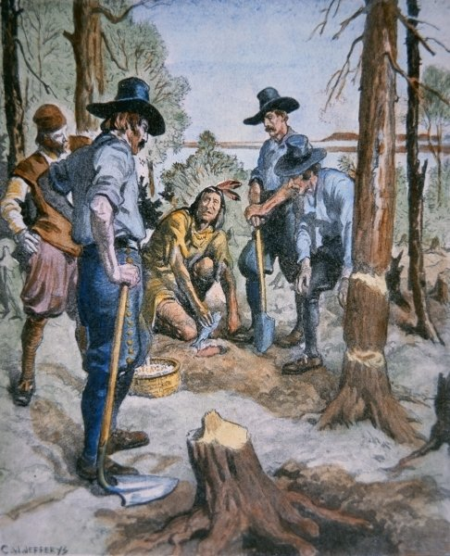
The Pilgrim Fathers were businessmen and gentlemen, but now they had to learn to cultivate the land and build houses
For the first months they slept on the “Mayflower”. They made friends with the natives who taught them their farming methods.

Slide 7
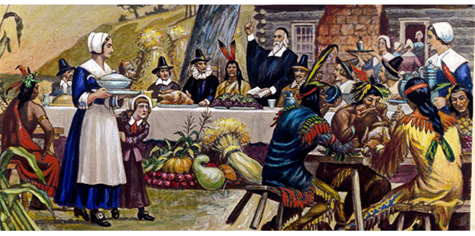
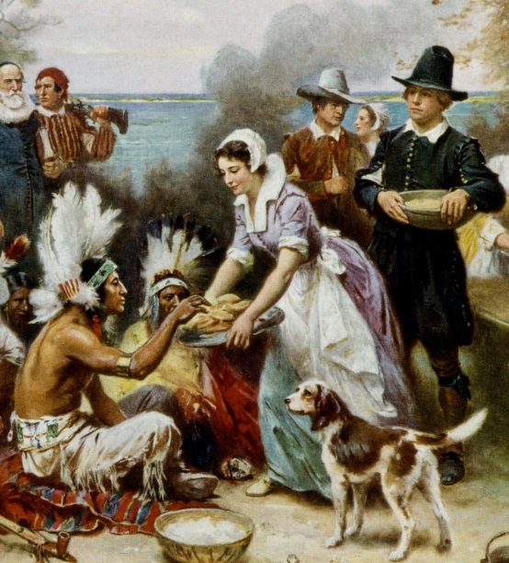
In autumn 1621, the 51 surviving Pilgrims and about 90 Indians participated in the first Thanksgiving celebration. The celebration lasted 3 days but it was probably quite solemn because Puritans didn’t like parties.
They ate wild turkeys and fish caught by colonists and 5 deer brought by Indians.

Slide 8
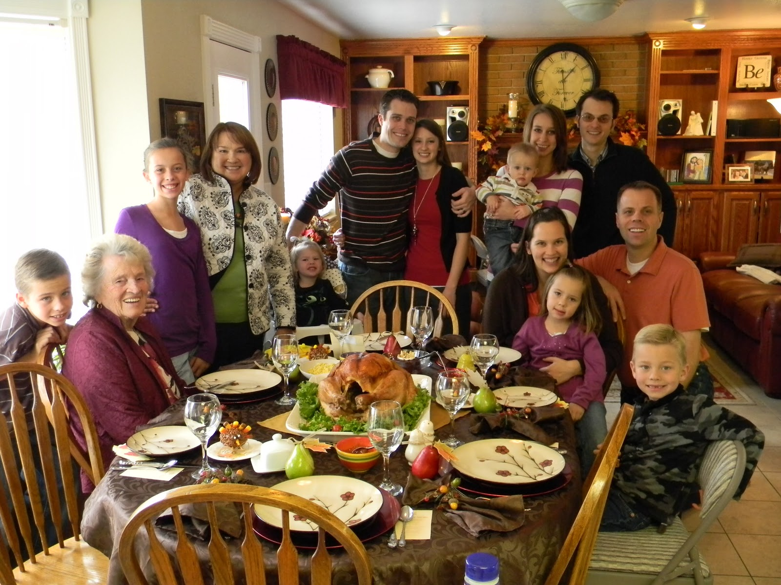
Today, Thanksgiving day is a special family holiday celebrated in the USA on the fourth Thursday in November.

Slide 9
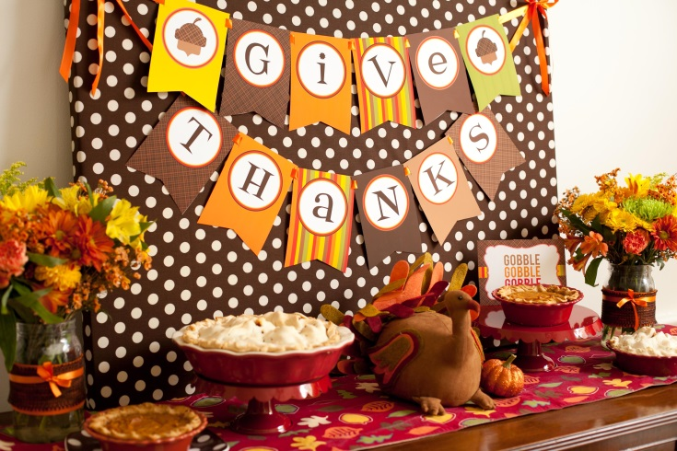
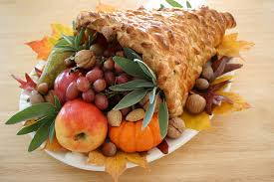
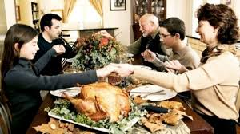
People usually take a long holiday weekend and families try to be together. Americans decorate their houses for Thanksgiving and make cards and special food.

Slide 10
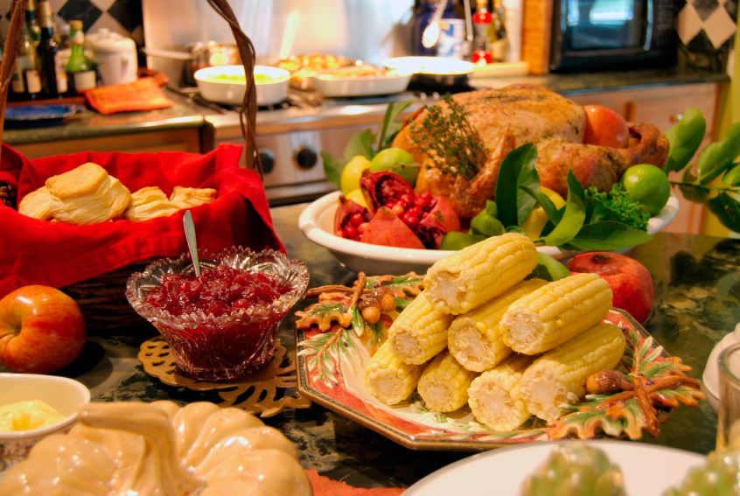
The traditional food is turkey, sweet corn, mashed potatoes, cranberry sauce and pumpkin pie. They start the meal saying thanks to God.

Slide 11
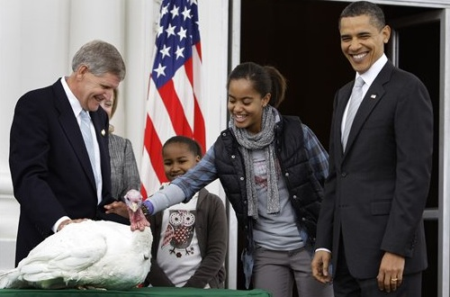
During the weekend Americans eat about 40 million turkeys! But some days before Thanksgiving the President “pardons” two turkeys in an official ceremony at the White House. People choose the names of the two lucky animals who can survive and live freely.

Slide 12
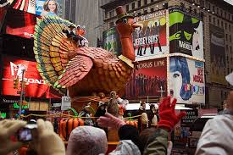
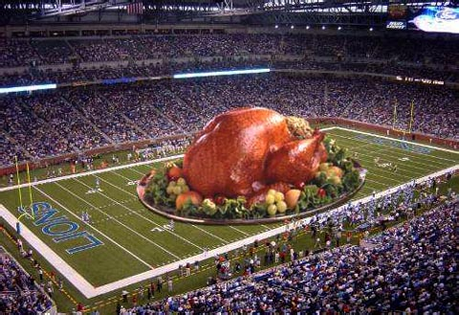
During the weekend they do lots of activities together. For example, they watch a special football game in the evening, or they watch a famous parade on 5th Avenue in New York, organized by Macy’s, one of the biggest department stores in the world. The parade always ends with a visit from Santa Claus, marking the beginning of Christmas period.

Slide 13
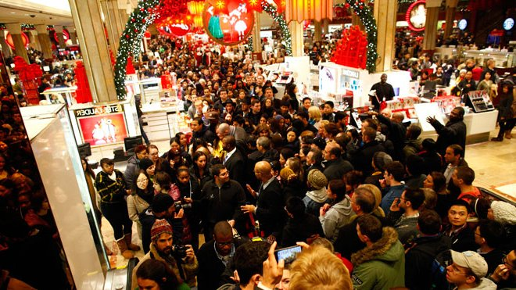
The following day it’s called “Black Friday”. Big shops open very early (and more recently during overnight hours) and offer promotional sales. It is the busiest day of the year for shops.
Now there is also “Cyber Monday” (the Monday after Thanksgiving) : it is the day of sales for electronic shops.

